Slide 1
WALKING LIGHT

Slide 2
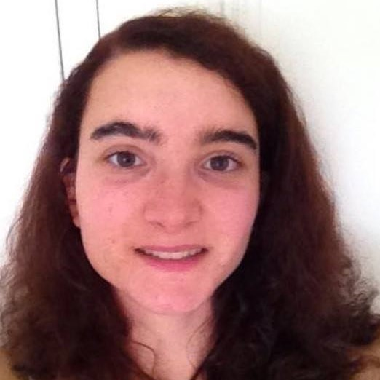
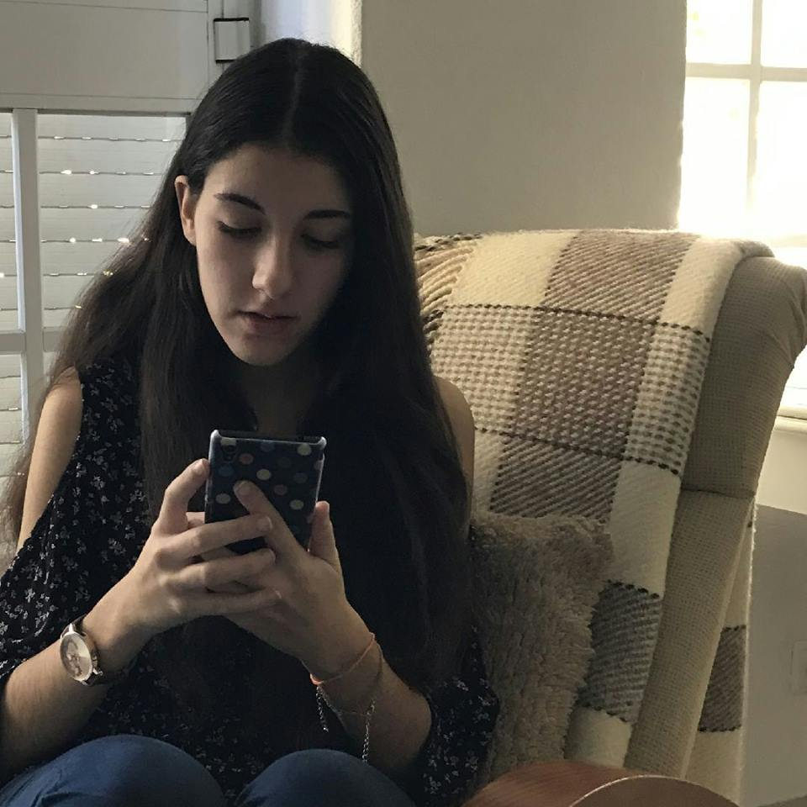
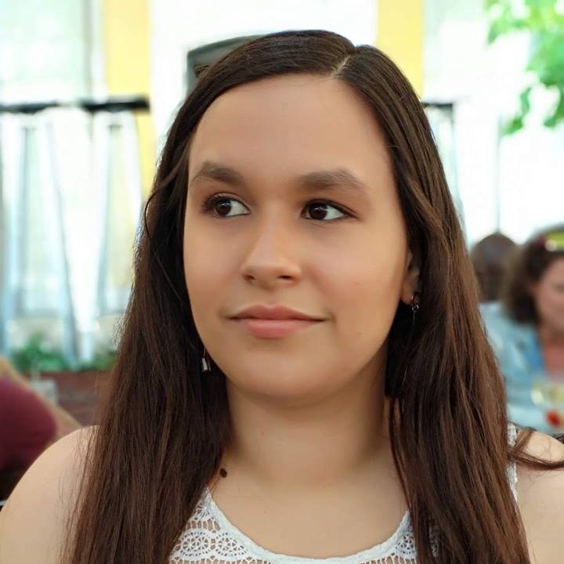
Bárbara Ramalho
GROUP MANAGER
Mafalda Morgado
RESEARCHER
Nádia Mourão
DESIGNER

Slide 3
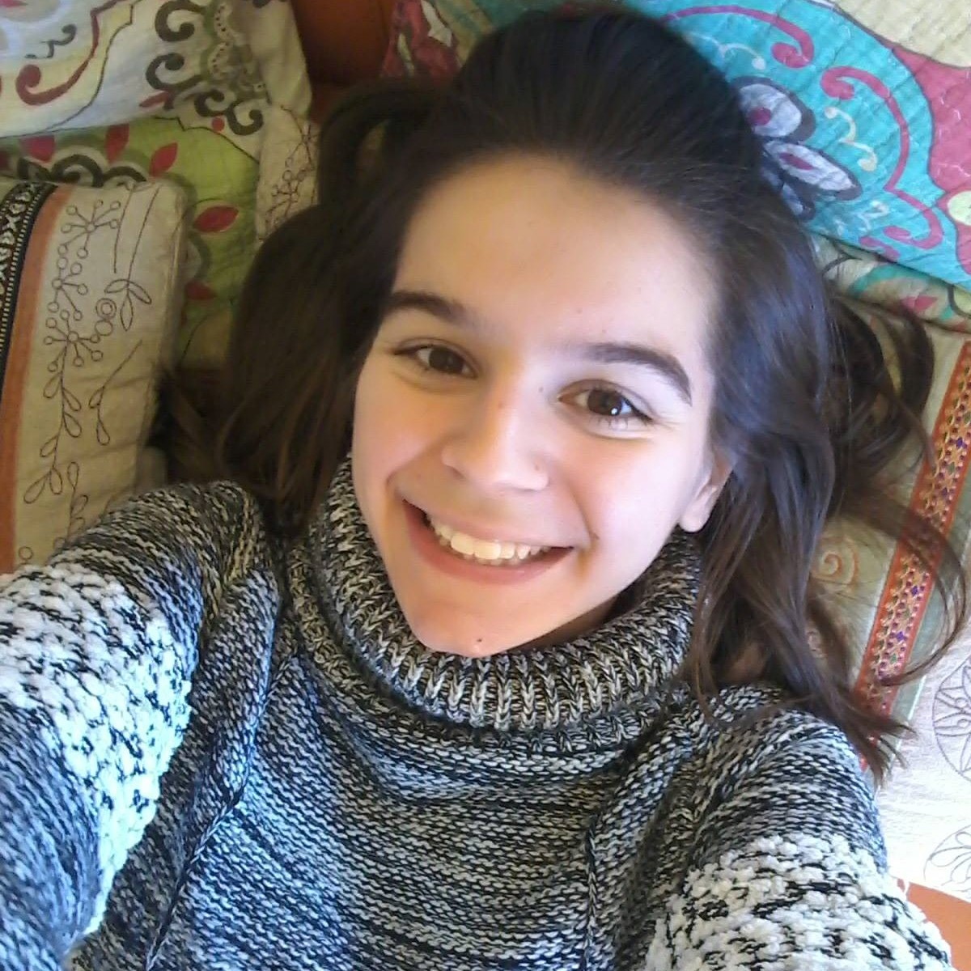
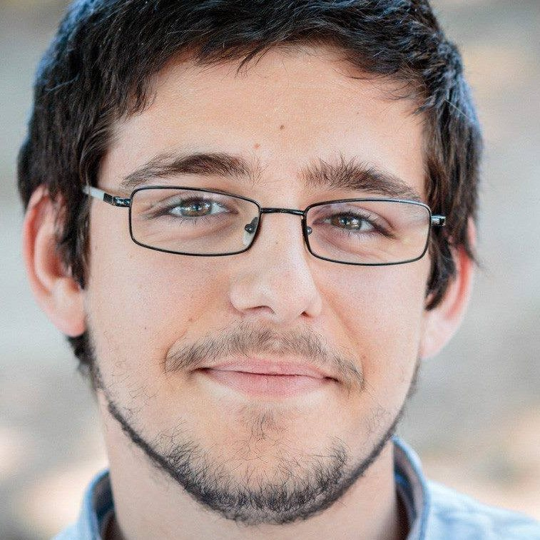
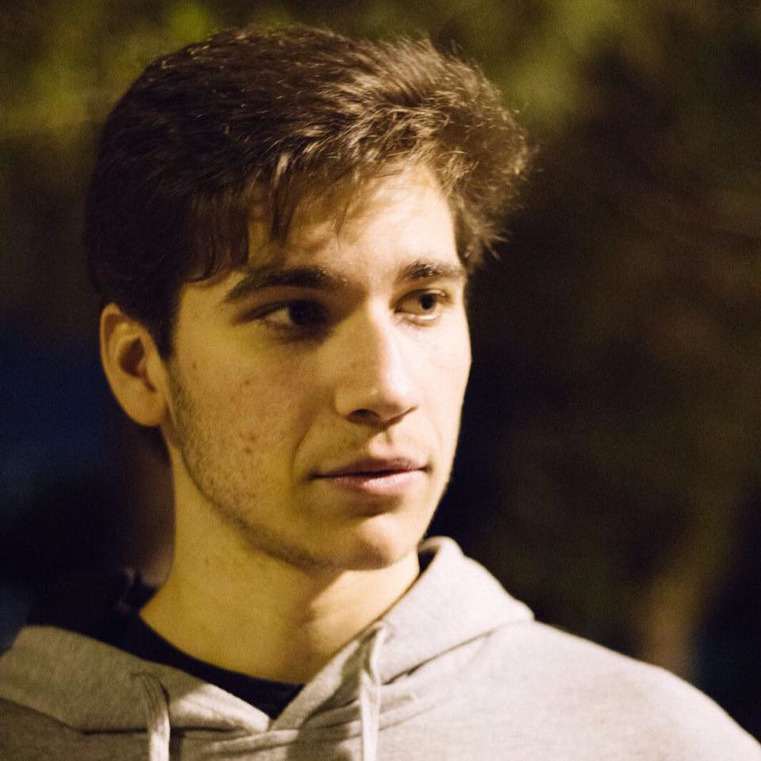
Carolina Veloso
FRONT-END DEVELOPER
Hugo Lencastre
BACK-END DEVELOPER
André Vieira
BACK-END DEVELOPER

Slide 4
SOLUTION CONCEPT

Slide 5
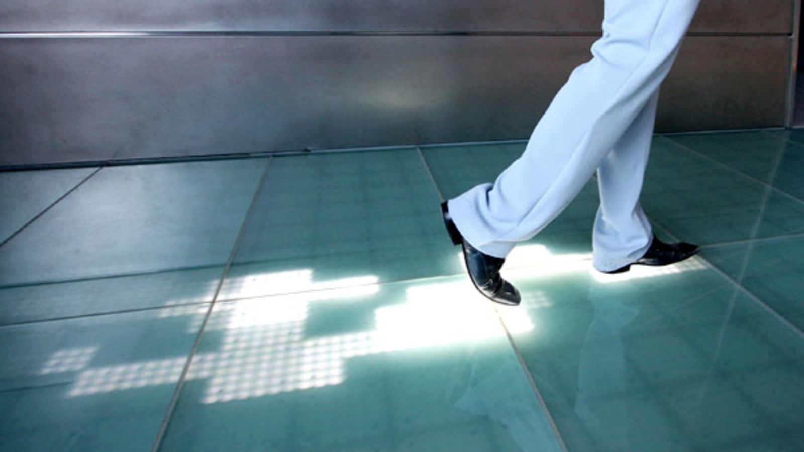
INTERACTIVE PLATFORM

Slide 6

Colour Code
Green
Valid Ticket
Orange
Invalid Ticket
Red

Slide 7


PLATFORM – ARRIVAL

Slide 8
PLATFORM – GOING TO VALIDATE

Slide 9
PLATFORM - VALIDATING

Slide 10
PLATFORM - VALID

Slide 11
PLATFORM – WALK FREELY

Slide 12
INVALID TICKET

Slide 13
PLATFORM – TRY TO VALIDATE AND FAIL

Slide 14
PLATFORM - VALID

Slide 15
Time Out

Slide 16
PLATFORM – IN THE BEGINNING

Slide 17
PLATFORM – AFTER 1 MIN

Slide 18
USER STEPS OUTSIDE THE PLATFORM

Slide 19
PLATFORM - VALID

Slide 20
PLATFORM - VALID

Slide 21
PLATFORM - VALID

Slide 22
LEAVING THE TRAIN

Slide 23
PLATFORM

Slide 24
PLATFORM - LEAVING THE TRAIN

Slide 25

TICKET INSPECTORS

Slide 26
PLATFORM

Slide 27

IMPROVEMENT

Slide 28
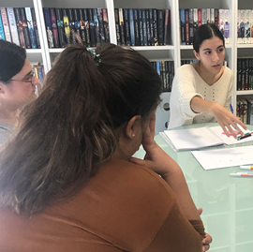
IMPROVEMENT
This system was validated by our user research, and improved in design iterations, where we organized interviews, focus groups, formative user studies and usability testing to make sure that users felt comfortable and found our solution intuitive and effective.

Slide 29

FEEDBACK
Main reason why people don’t validate
Because they forgot or were in a hurry to catch the subway

Slide 30
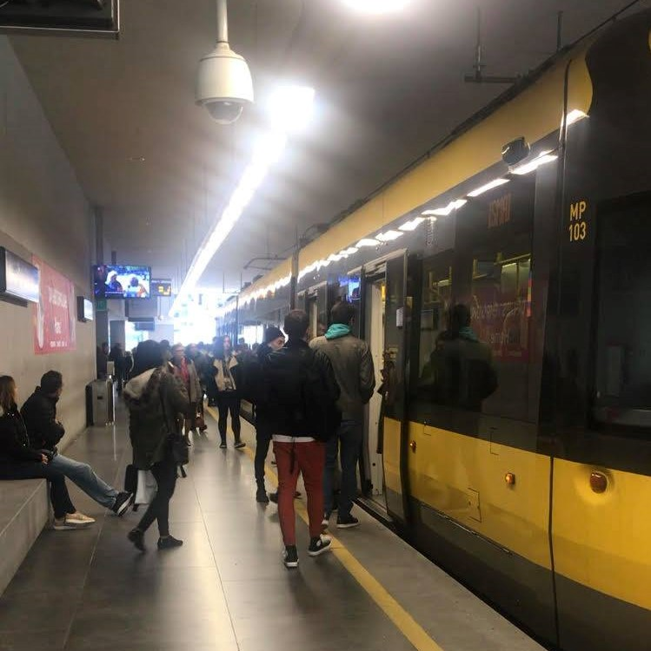
RESEARCH
This was actually confirmed when two members of our team went on the trip to Porto to study the infrastructures and understand the system, and caught the subway, forgetting to validate their tickets.

Slide 31
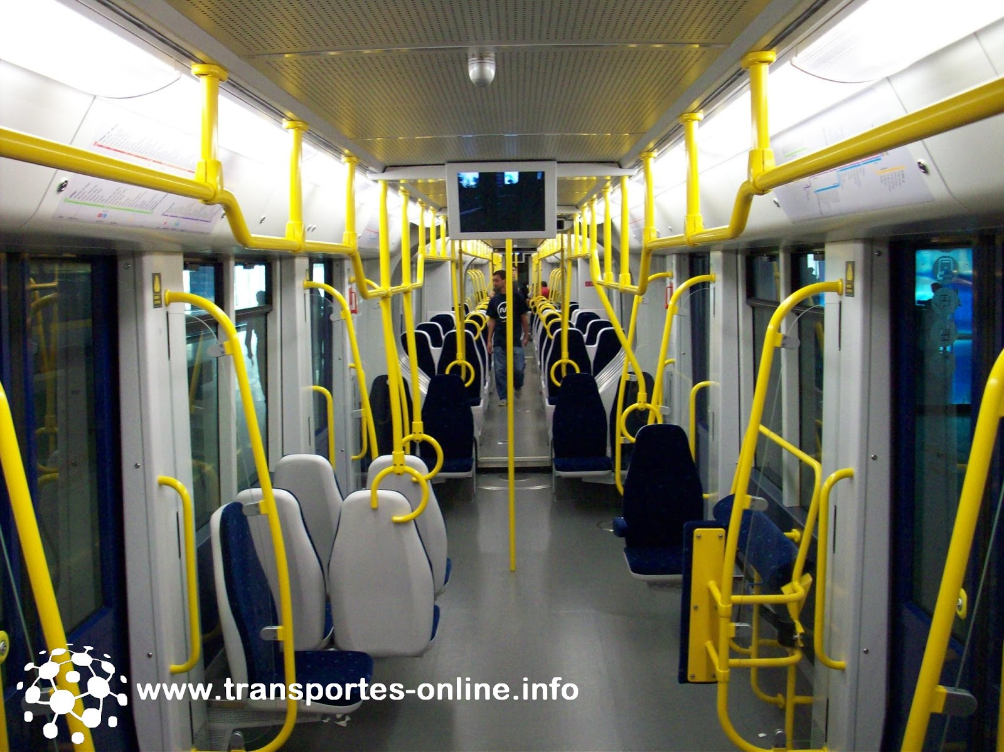
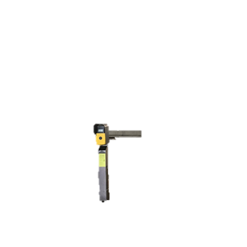
ADDITIONAL VALIDATORS

Slide 32
We understand that this would encourage people to always use the subway without validating their tickets, and only validate inside the carriage when a ticket inspector approaches.

Slide 33
LOG IN
AS DUAS HIPOTESES

Slide 34
ESCOLHA DA ESTACAO
LISTAS DE COMBOIOS

Slide 35
IMAGEM DA ESTACAO
BLOQUIAR

Slide 36

USER RESEARCH

Slide 37


Slide 38
OUR GOAL?
Understand our users.

Slide 39
USER RESEARCH
Methods used:
Enquiry
Field observations
Flash Interviews
One-on-one interviews
Focus groups

Slide 40


FEELINS
Who do it
Fear
Anxiety
When seeing it
Bothered
Judgmental
Indifferent

Slide 41
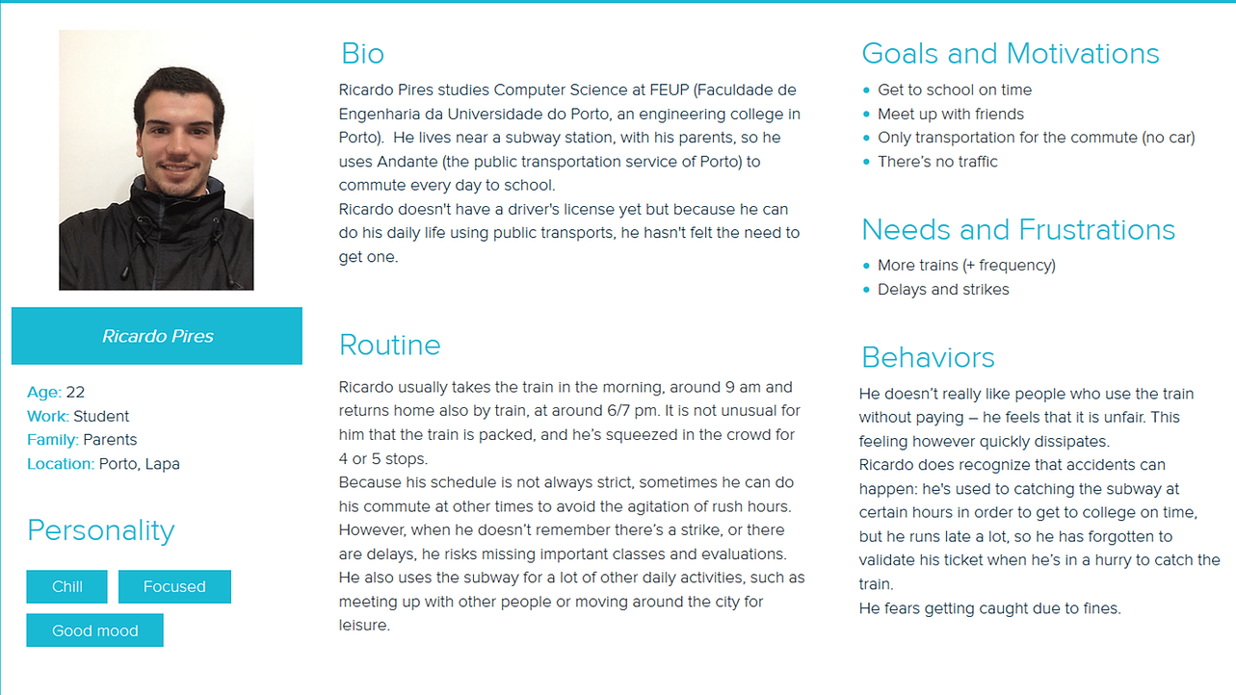
Persona

Slide 42
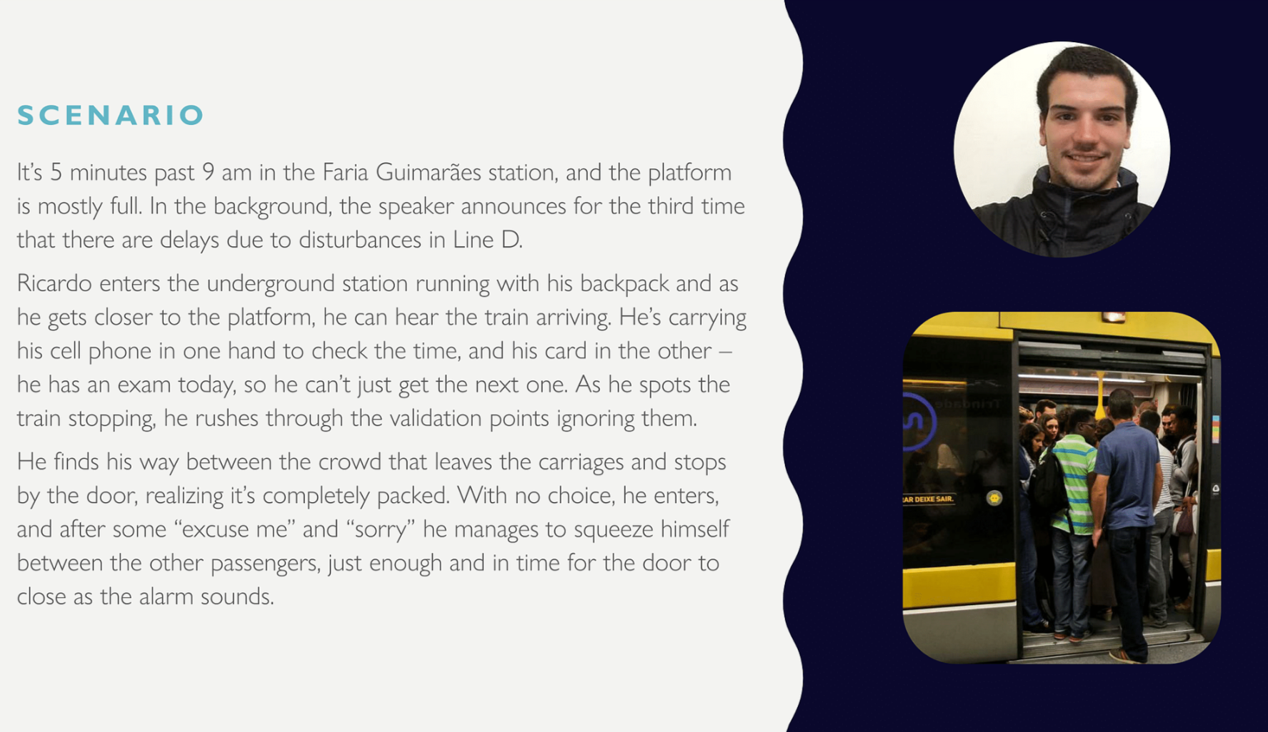
SCENARIO

Slide 43
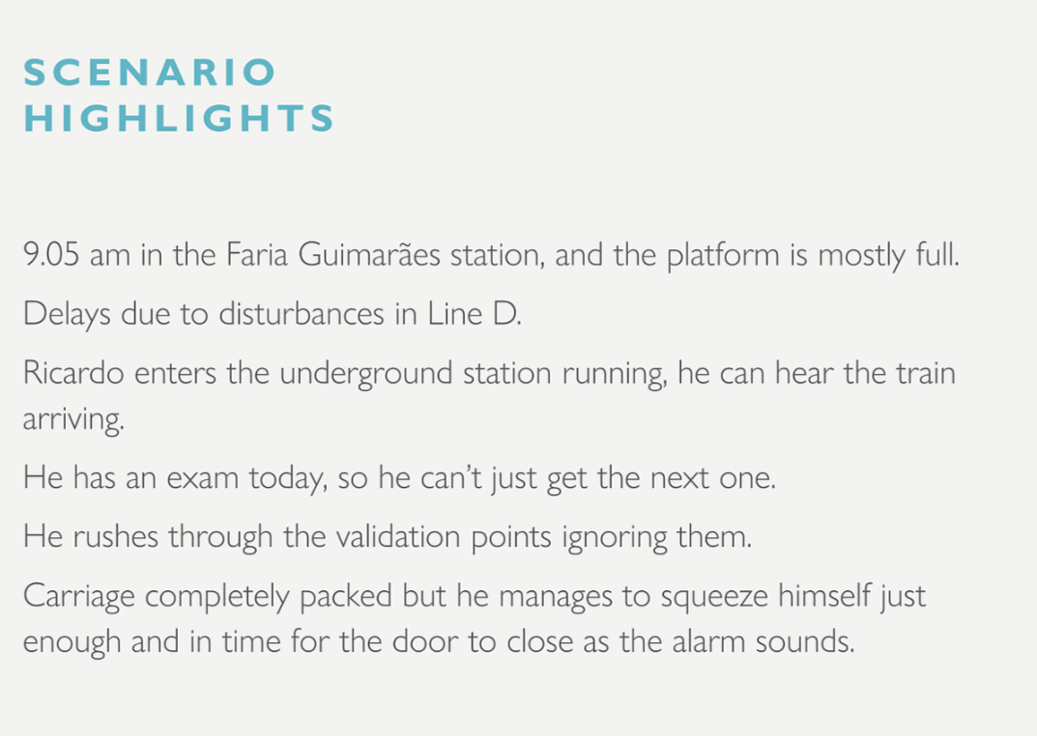
SCENARIO HIGHLIGHTS

Slide 44
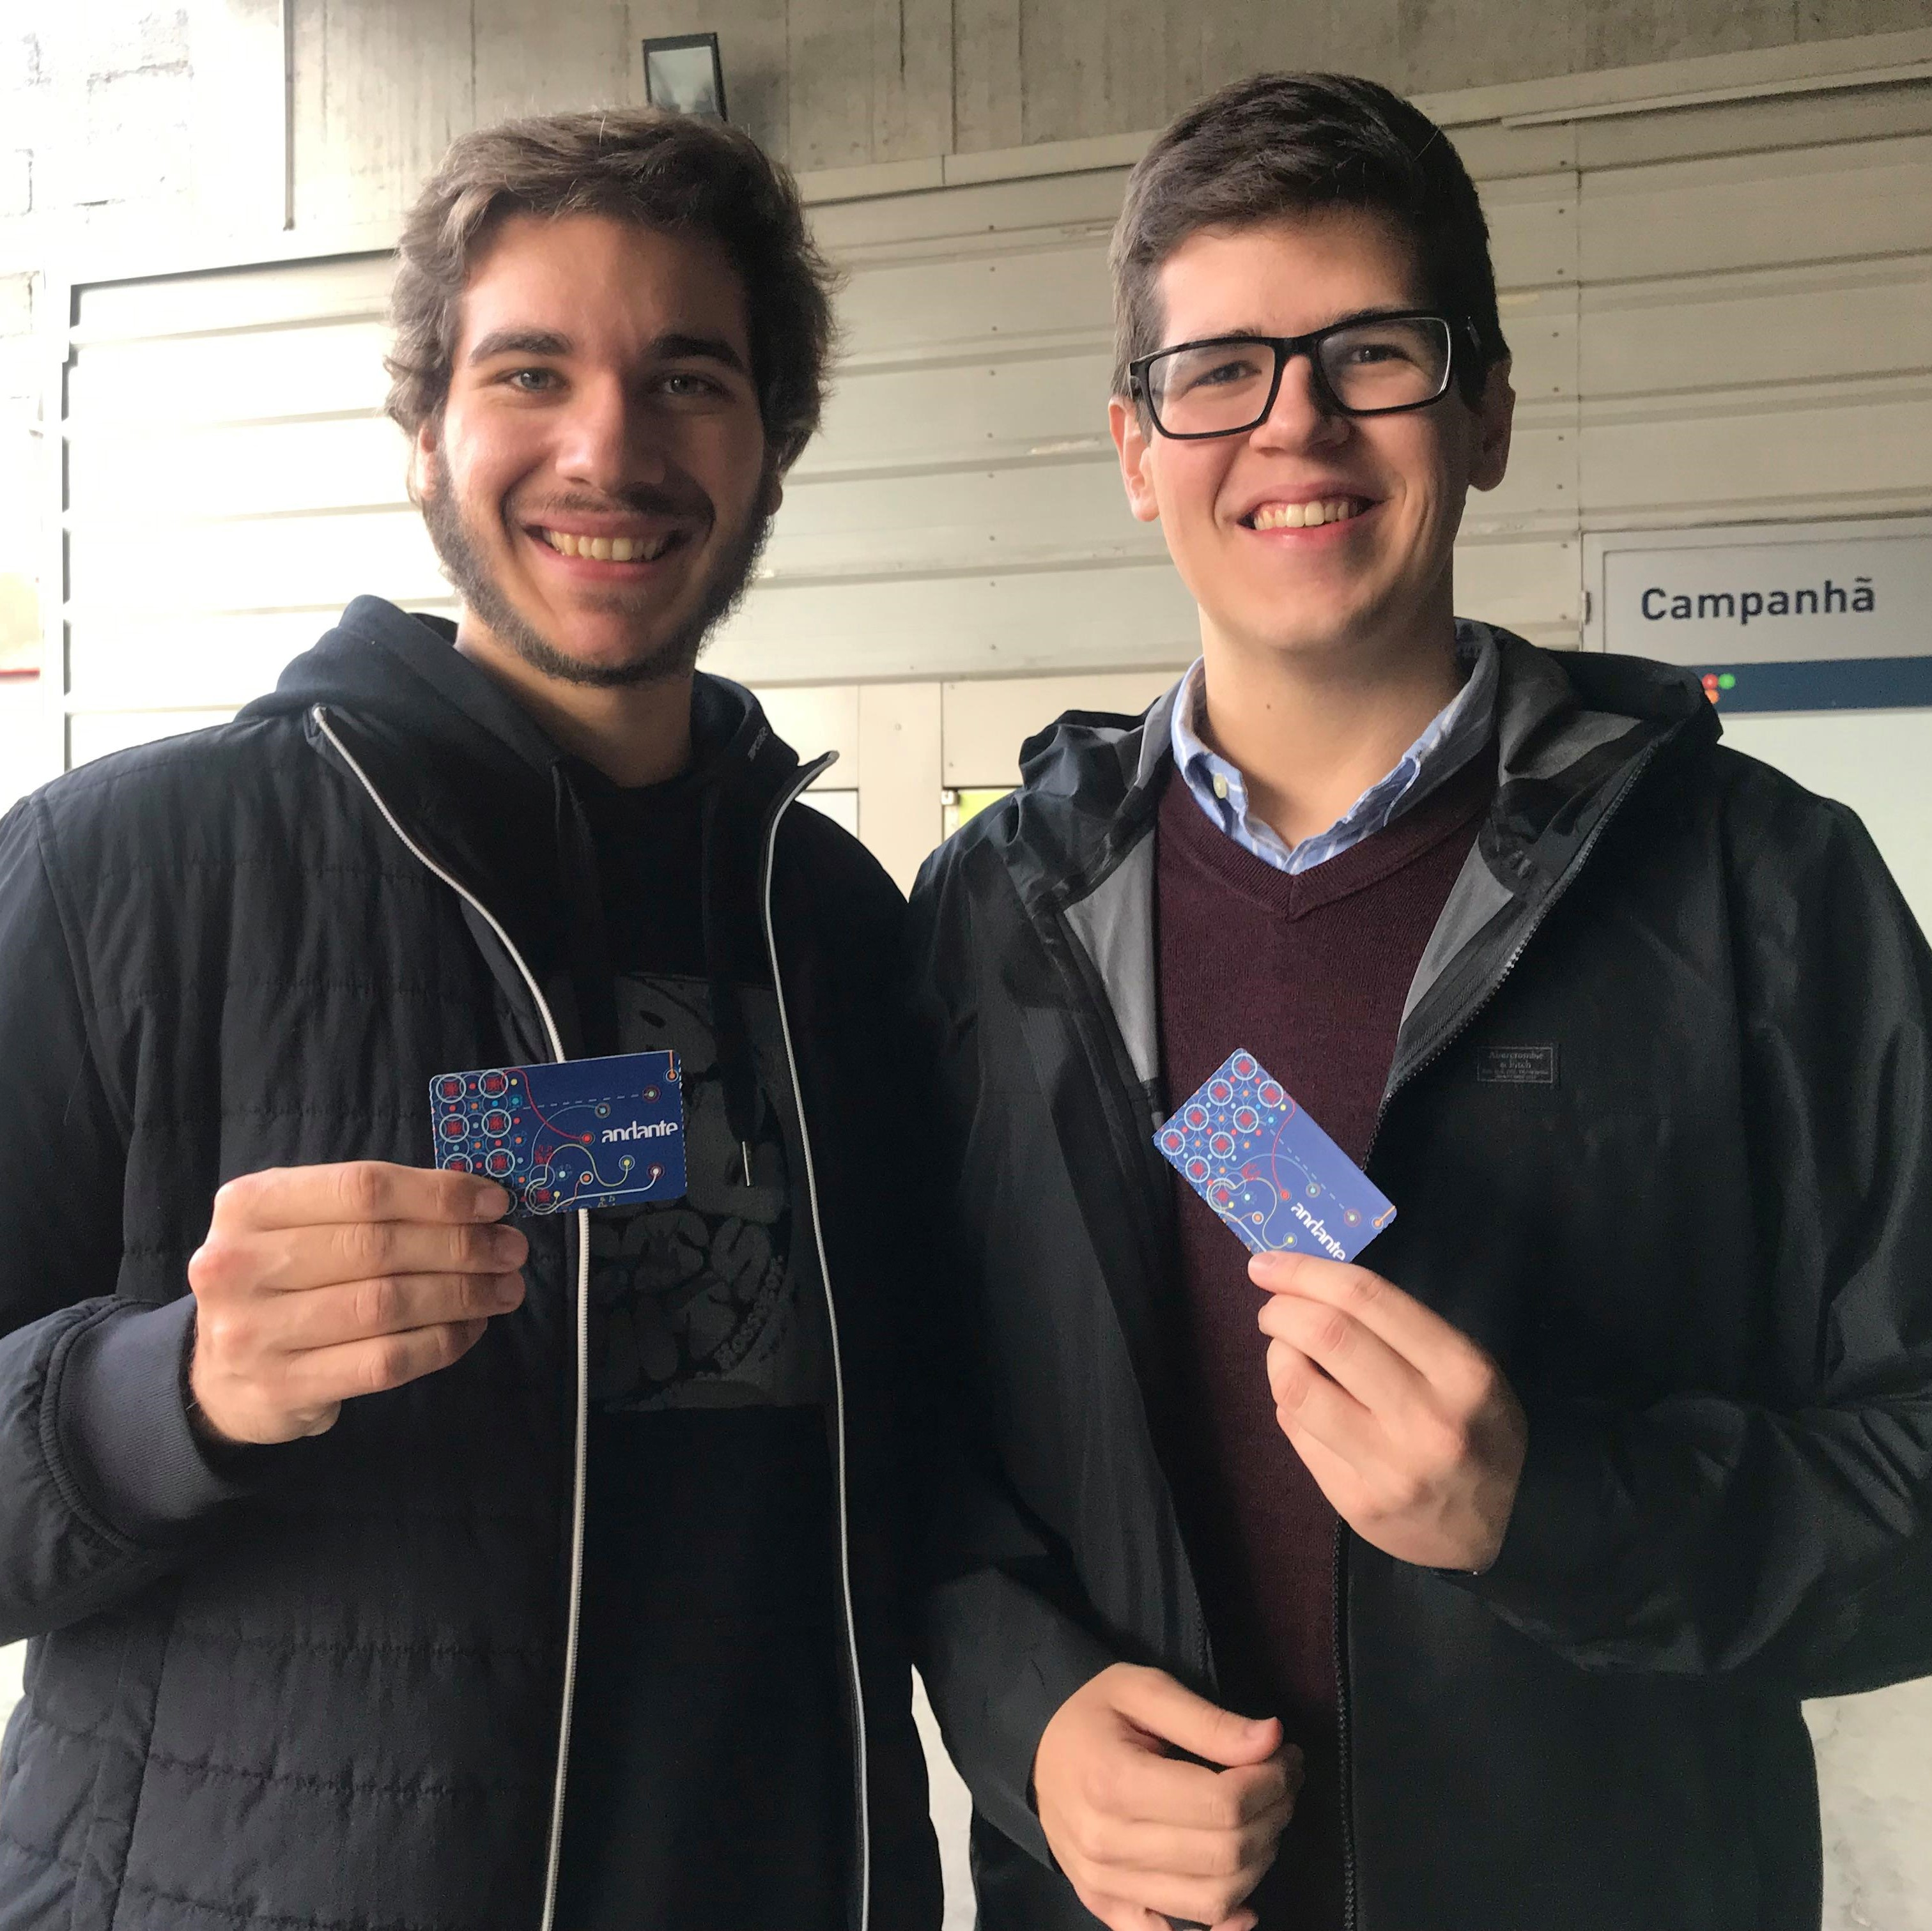
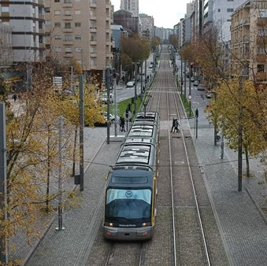
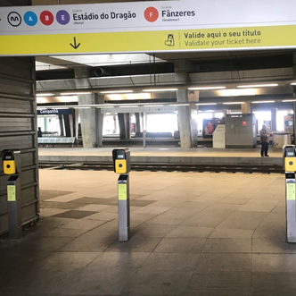
WE ALSO WENT TO PORTO

Slide 45

DESIGN PROCESS

Slide 46


DESIGN PROCESS
TESTING
REFINING

Slide 47
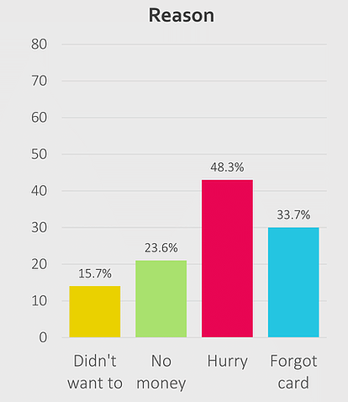
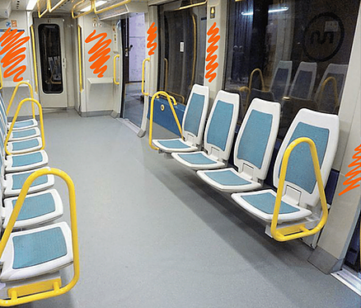














Slide 48
BUDGET SKETCH

Slide 49
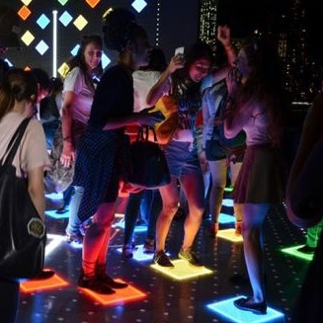
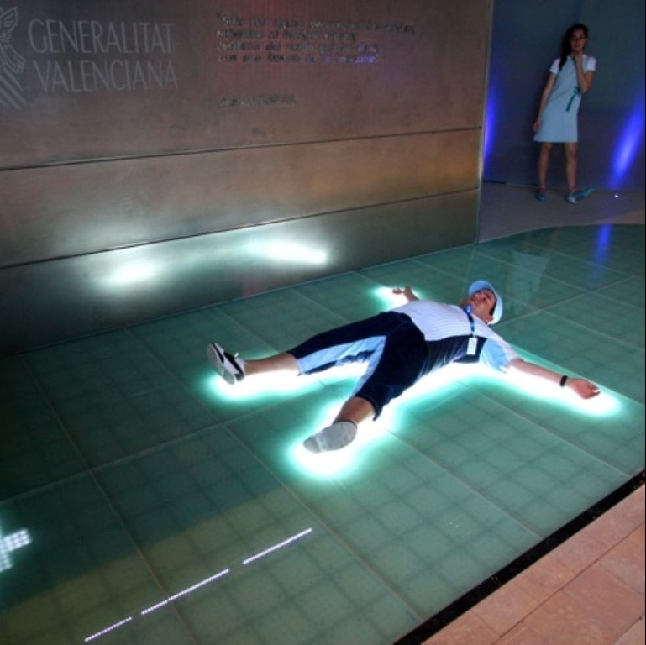
TWO MAIN IDEAS
BRIGHTLOGIC
SENSACELL

Slide 50
DELIVERABLES – AS IS

Slide 51
Unity Simulation
Adapted to VR, allowing us to demonstrate the future behaviour of our solution in action, in an interactive environment.
App
for revisors to monitor the platform and shut down the inside validators, that can be merged to fit their current system.

Slide 52
Thank you!
ANY QUESTIONS?
You can find us at:
https://walkinglight.wixsite.com/ccu-group7

